Slide 1
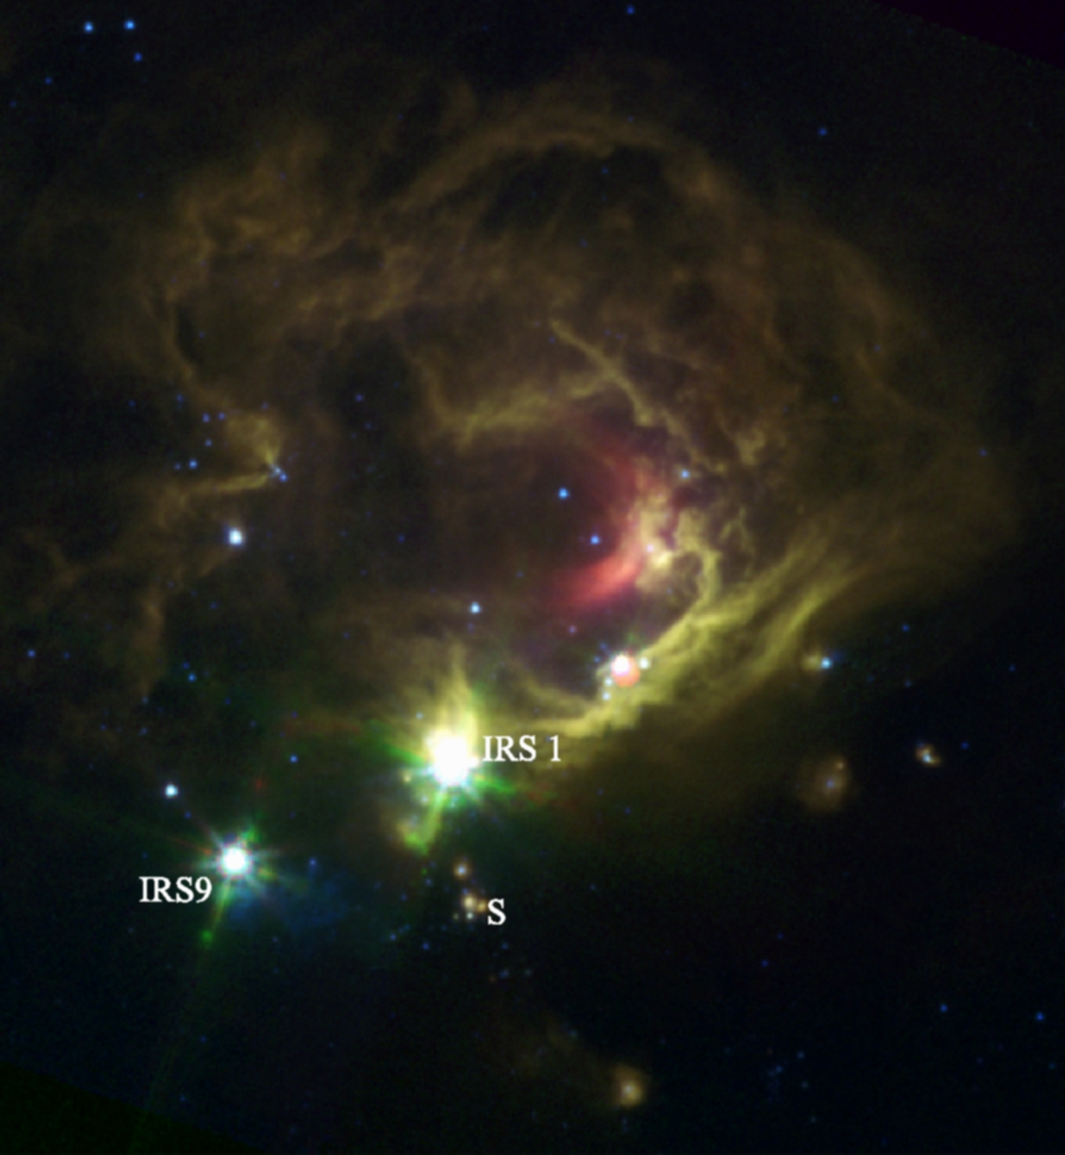

Rotating Disks around O-type Young Stars in NGC7538 IRS1
3D Gas Dynamics from Methanol Masers observed with the EVN
Ciriaco Goddi

Slide 2
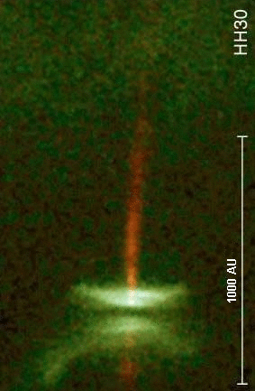
What do we need from observations?
High-mass Star Formation is an unsolved problem
(The “feedback” problem)
Open Q. :
How do massive stars accrete their mass once in ZAMS?
Signatures of mass-accretion
And Disks around O-type Young Stars
Challenging because of:
High extinction => Optical and NIR impossible
Formation in clusters => Confusion/crowding
Declining IMF and Rapid evolution: Large Distances (> 1 kpc)
Good examples of accreting massive YSOs are rare!

Slide 3
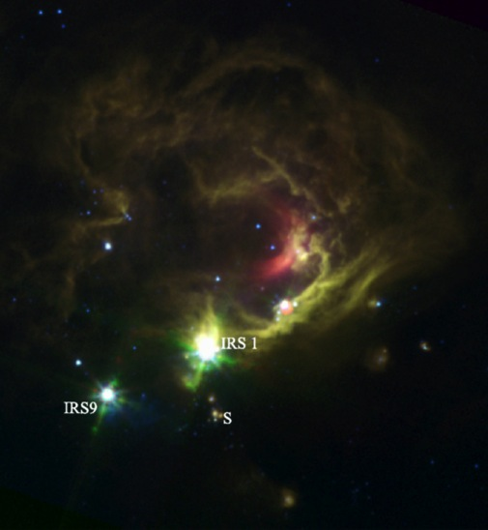
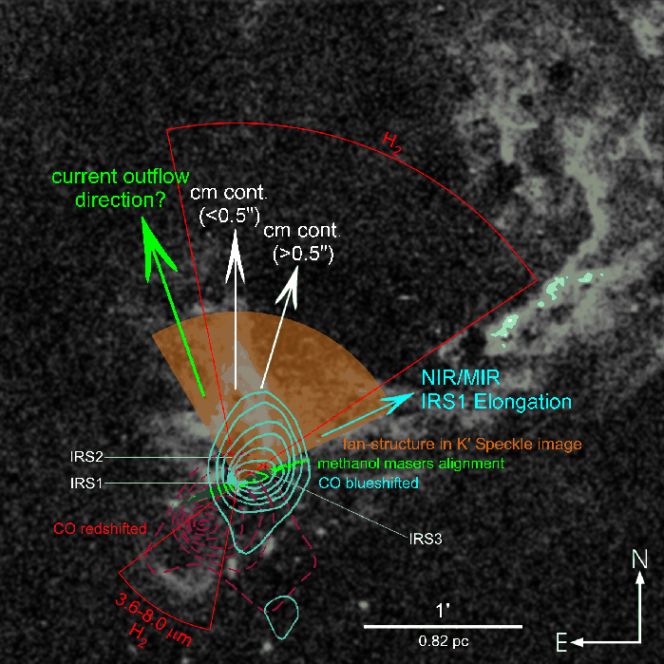
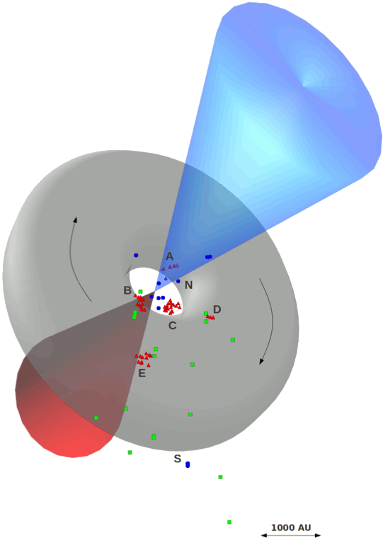
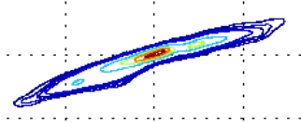
NGC7538 IRS1: an accreting O-type Star
D~2.7 kpc, L~10⁵ L ➔ O6-7 star of 30 M
Perhaps the best/closest high-mass accretion disk candidate around an O-type YSO in the northern emisphere
HCO+
- Outflows?
  PA=+20°, 0°,
  -20°, -50°
  e.g. Gaume+95,
  Qiu+11, Beuther+13
  A precessing jet?
  Kraus+06
- Disks?
  Keplerian (edge-on) disk: NW-SE
  Pestalozzi+ 04
  Massive Toroid: NE-SW Surcis +11
Q: Is there truly one single O-type YSO surrounded by an accretion disk, driving a single outflow?
Notes:
if one single object dominates the region’s luminosity, this might be the closest most massive forming star
SO, we find ourselves in the uncomfortable position of having multiple Outflows and with an and with an asymmetry wrt disks’ orientations

Slide 4
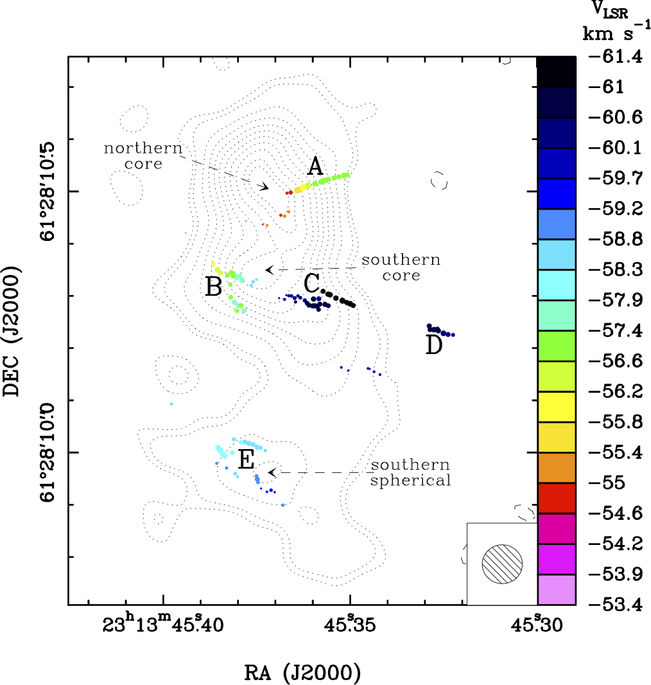
NGC7538 IRS1
...as seen with the eyes of the EVN and methanol masers…
6.7 GHz EVN archival data
4 epochs from 2002 to 2009
Positions
l.o.s. velocities
See also :
Minier et al. 98
Pestalozzi et al. 04
Surcis et al. 11
What’s new here:
Proper motions
Accelerations
Kinem. Disk Model
1.3 cm continuum (VLA-A)
Gaume et al. (1995)

Slide 5
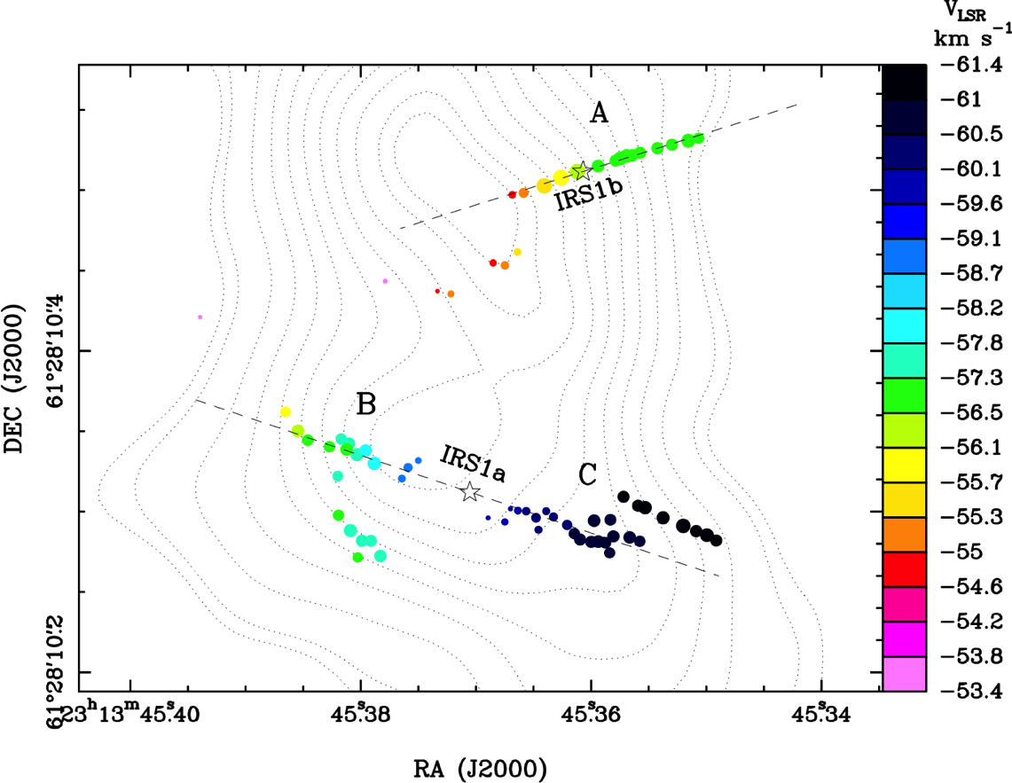
NGC7538 IRS1
I. Positions and l.o.s. velocities
Maser clusters show:
two linear distributions
regular vel. gradients
Linear fits identify the PA of the two edge-on disks
The geometric centers of the masers give the stellar positions
Our hypothesis: Two massive YSOs surrounded by disks within 500AU

Slide 6
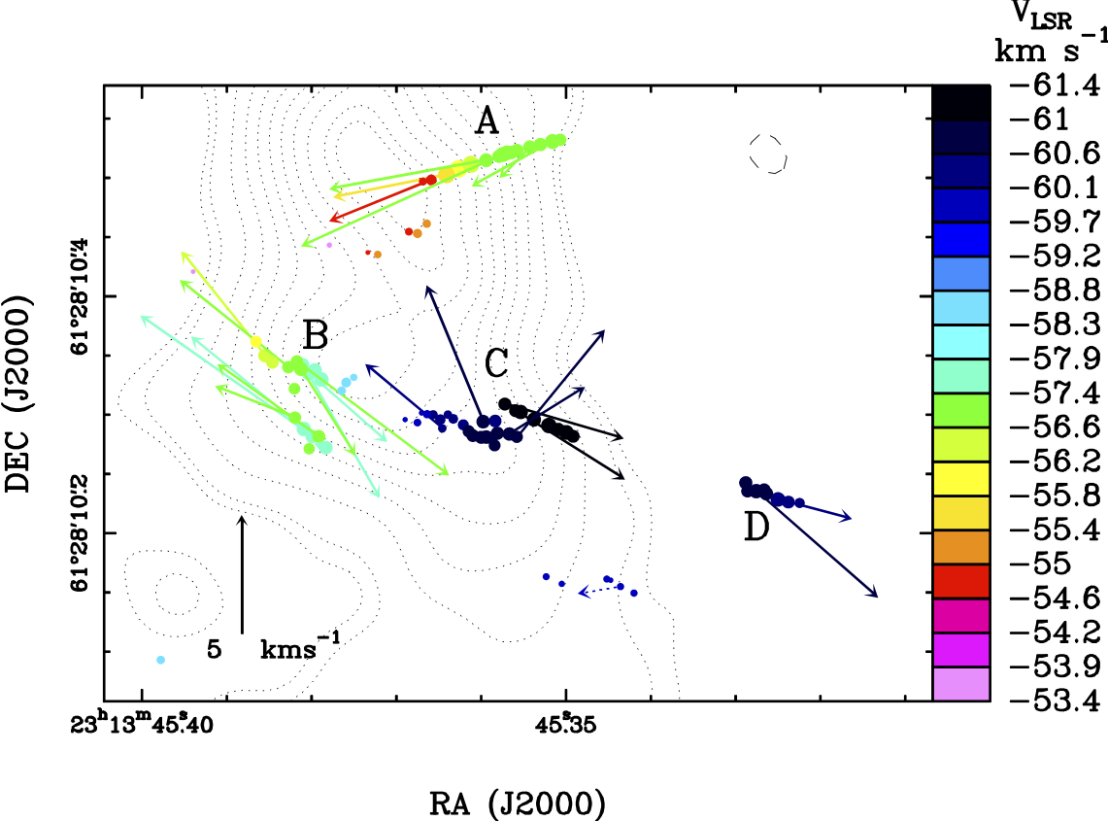
NGC7538 IRS1
II. Proper Motions
PMs = 1-9 km/s
Proper motions are approximately parallel to the elongation axis

Slide 7
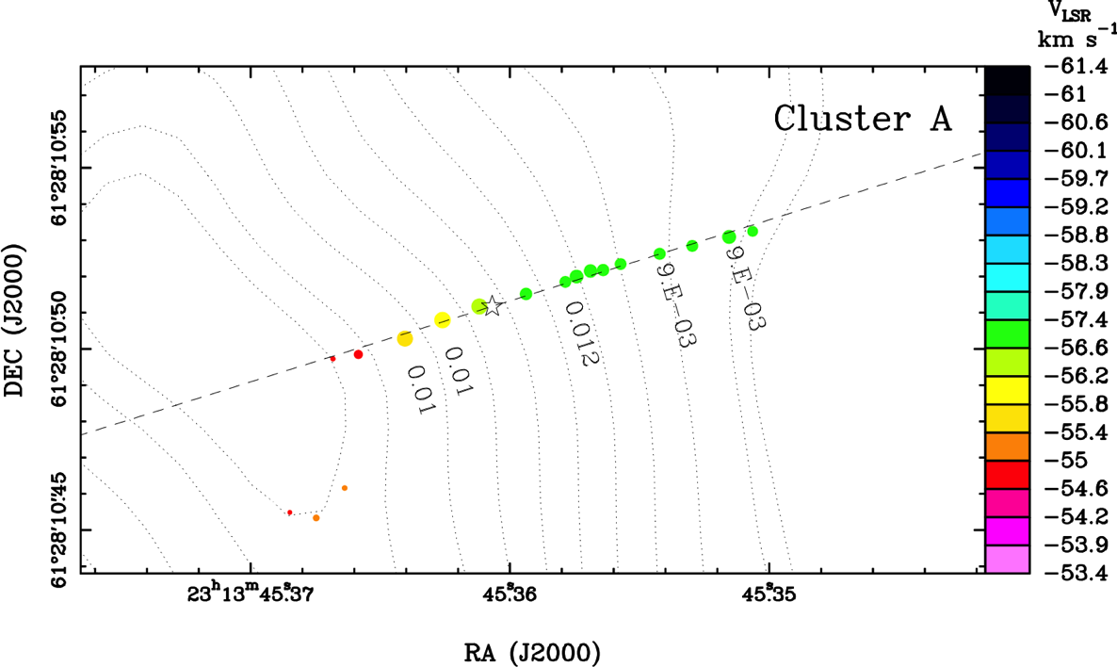
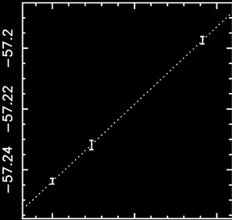
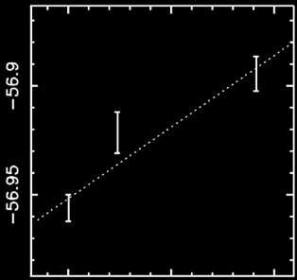
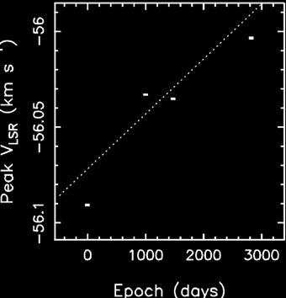
NGC7538 IRS1 lII. l.o.s Accelerations
Peak Velocity vs. Time
Individual masers have similar accelerations (~0.01 km s⁻¹ yr⁻¹) along the distribution axis
This is consistent with centripetal acceleration in a rotating (edge-on) disk

Slide 8
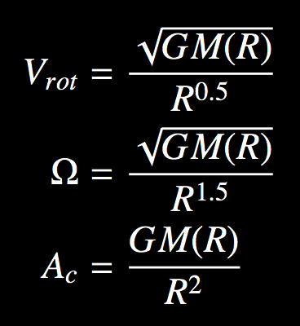

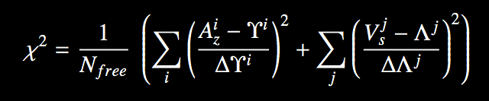
Edge-on Disk Model
For an edge-on disk in centrifugal equilibrium:
Rotation
Velocity
We can express these quantities with just 2 free parameters:
q describes how the mass distributes in the disk
Angular
Velocity
Centripetal
Acceleration
R₀ describes the disk radius at the star position along the l.o.s.
R=F(R₀,q)
The best values of R₀ and q are derived by minimizing the χ2 :
Accelerations
3D Velocities
Notes:
We have shown that the regular pattern in VLSR can be reproduced if masers distribute on the edge-on disk along specific curves described by the two parameters R0 and q. Now, we can use our measurements of maser l.o.s. accelerations and proper motions to constrain the model of edge-on rotation and derive the best values of R0 and q

Slide 9
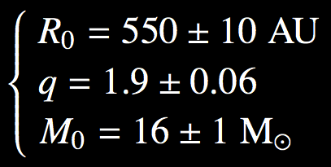
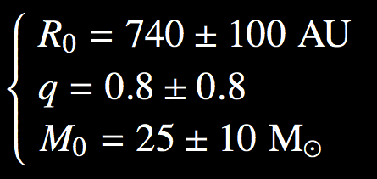
Parameters of the two Edge-on Disks
Fit to positions, l.o.s. velocities, accelerations, and proper motions of maser spots, provides
IRS1b
IRS1a
Keplerian disks may exist around massive O-type YSOs after all!
Moscadelli & Goddi, 2014, A&A, 566, 150
Notes:
IRS1B: 1) For q=2 the disk has a constant density and contains most of the mass! 2) The central star is still small but can grow to become a massive YSO
IRS1A: 1) A YSO with 25 M can dominate the L_{bol} of the region; 2) For q=0 the disk is Keplerian!

Slide 10
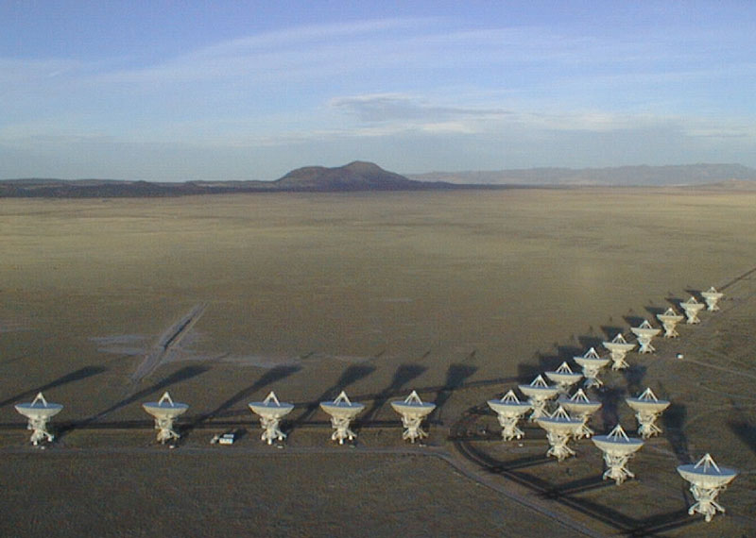
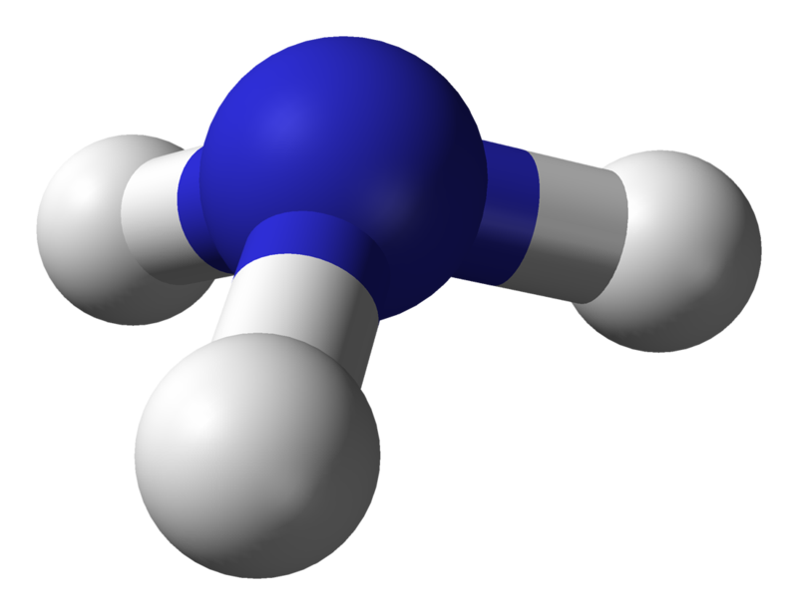
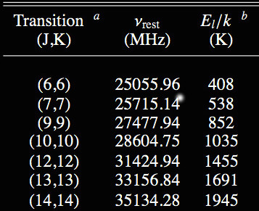
Any clues about the thermal gas?
N
H
  JVLA mapping of high-JK NH₃ lines
H
H
Excellent thermometer of dense molecular gas
Can trace excitation up to T∼2000 K within 20 – 40 GHz
JVLA with new broadband receivers can image all these inversion lines
Goddi et al. 2011b

Slide 11
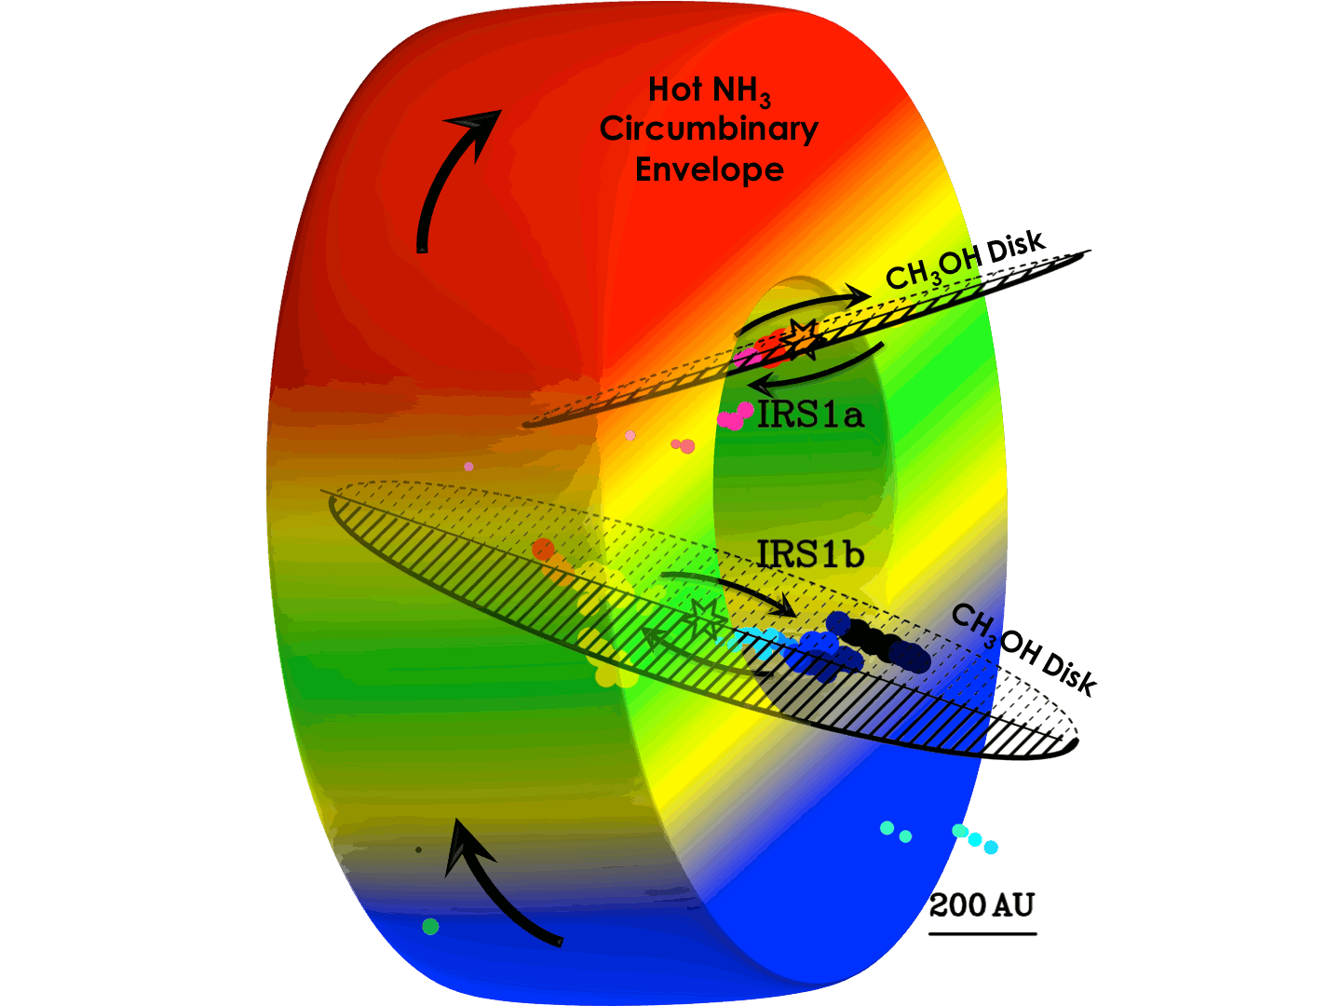
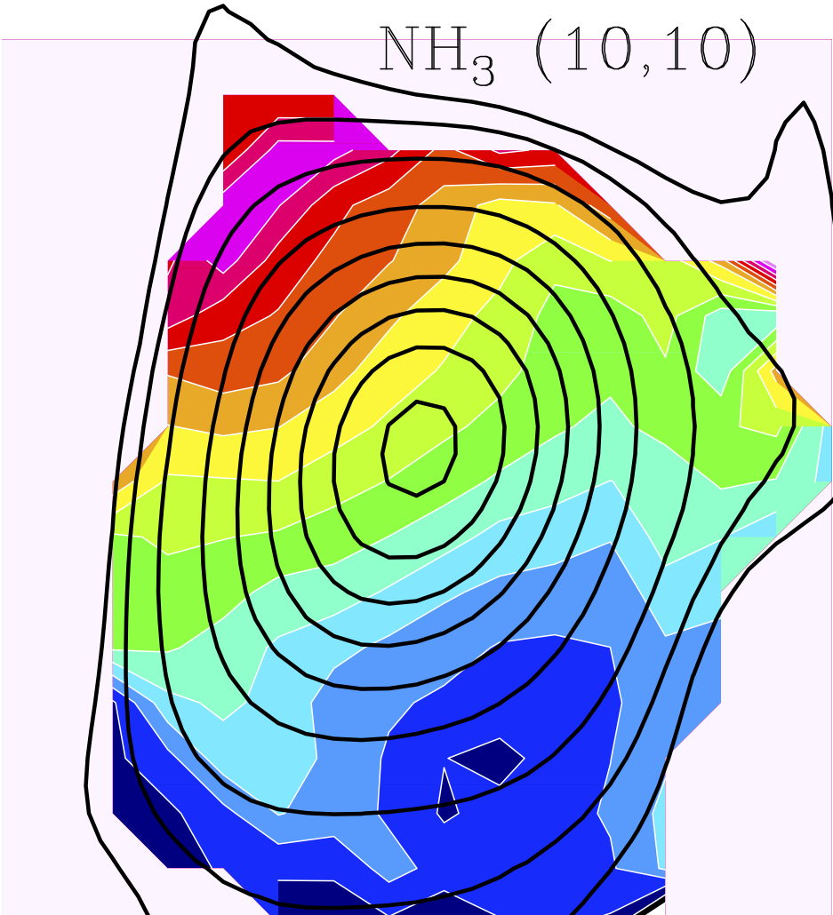
VLA-A
(θ=0.08”)
Velocity-channel centroid NH₃ maps
(13,13)
Moscadelli & Goddi, 2014
JVLA-B
(θ=0.2”)
North-South Rotation of the Hot Thermal Gas
Two accretion disks around two massive YSOs in the cavity of a rotating circumbinary envelope
Goddi, Zhang, & Moscadelli
(almost) accepted by A&A

Slide 12
Conclusions
3D Gas kinematics and l.o.s. dynamics of CH₃OH masers enabled us to identify 2 edge-on rotating disks and estimate parameters of star-disk systems
NGC7538 IRS1 hosts a circumbinary rotating molecular envelope, feeding two circumstellar rotating disks around two massive YSOs
GRATZIAS A TOTU!
Notes:
NEEDS WORK

Slide 13
EXTRA SLIDES

Slide 14
Rotation in Edge-on Disks
Five (independent) pieces of evidence strongly suggest edge-on rotation traced by maser clusters:
linear or elongated spatial distribution;
regular variation of V_{LSR} with position along the major axis of the distribution;
proper motions approximately parallel to the elongation axis;
average amplitude of proper motions (≈5 km s⁻¹) similar to the variation in V_{LSR} (4–6 km s⁻¹) across the maser cluster;
similar accelerations along the distribution axis is consistent with centripetal acceleration.
Notes:
TRASCURABILE

Slide 15
CH₃OH masers: Disks vs. Outflows
Linear distributions of 6.7 GHz masers with regular l.o.s. velocity gradients could trace collimated outflows (De Buizer 2003, 2009)
Counter arguments:
Cluster A", the maser VLSR increases concordly with the proper motions: the masers move and are accelerated towards and not away from the putative location of the exciting protostar.
Clusters "B"+"C", a collimated flow cannot explain neither the opposite orientation of velocity vectors nor the accelerations with both positive and negative sign in nearby maser features
Measured maser velocities (5 km/s) are too low with respect to typical velocities of protostellar jets

Slide 16
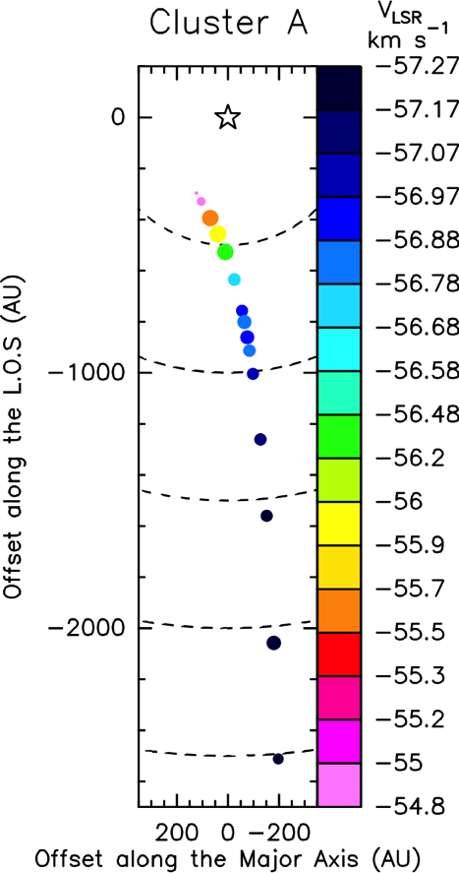
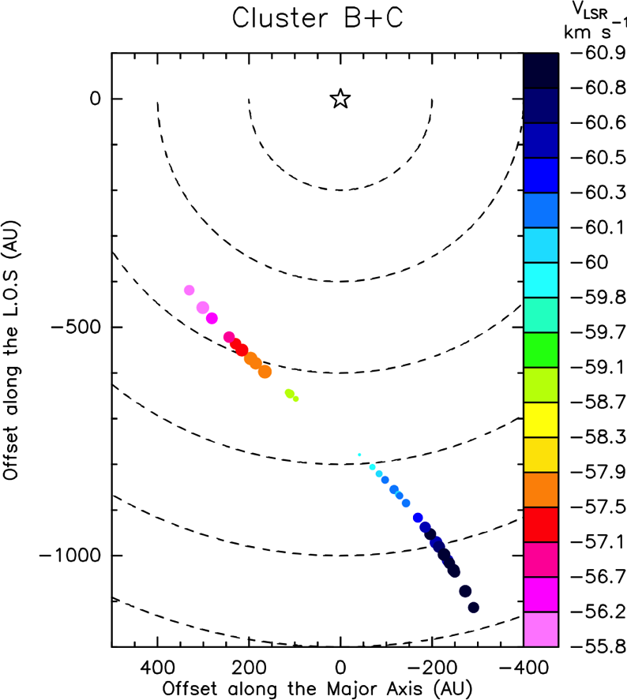
CH₃OH masers on the edge-on disks

Slide 17
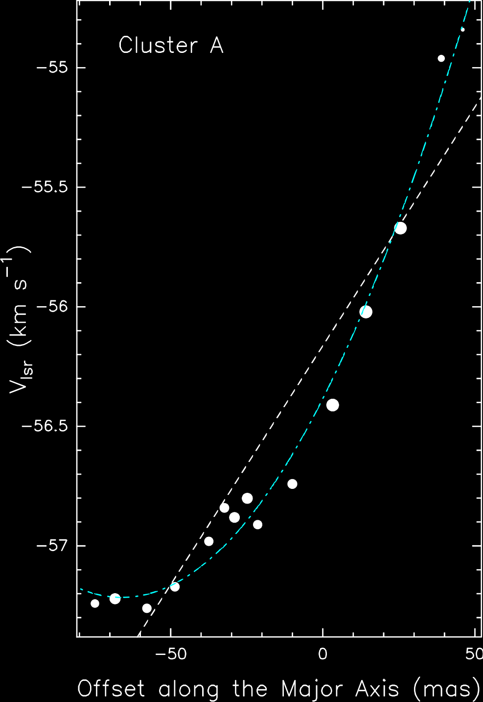
NGC7538 IRS1
The velocity vs position is plotted better by a quadratic curve
If s is the axis-projected position of a maser

Slide 18
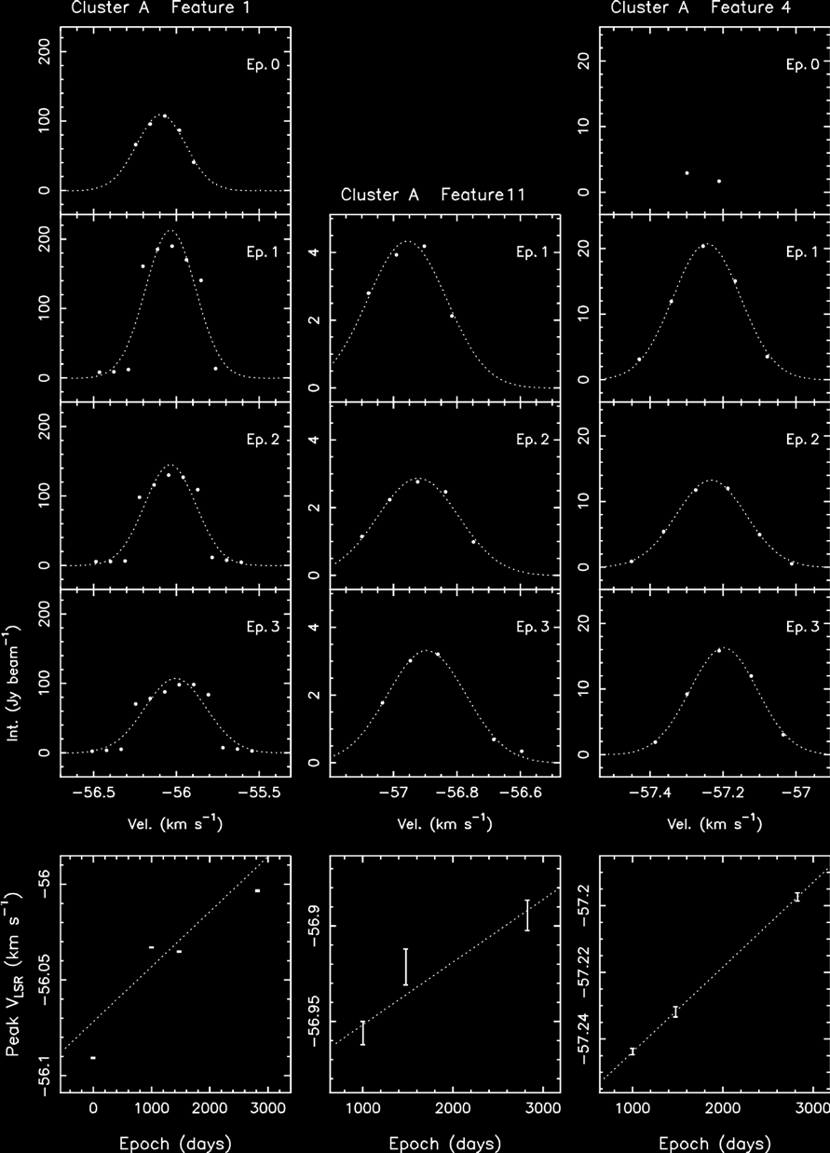
NGC7538 IRS1 lII. l.o.s Accelerations
Spectral Profiles of indvidual masers
Gaussian profiles fitted to the spectral emission allow us to measure the maser peak velocity with an accuracy of 0.01 km/s (vel. res.=0.09 km/s)
Peak Velocity Variations over Time
The linear trend of l.o.s. velocity with time, provides a direct measurement of acceleration

Slide 19
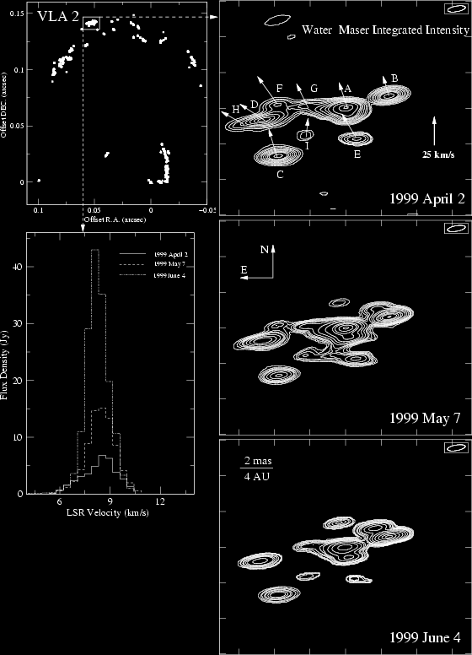
Molecular masers as diagnostic tools
Maser radiation originates from compact and bright maser spots
=> We can image them with VLBI!
Maser spectral components are extremely narrow (<1 km/s) => velocity with great accuracy
When observed at different epochs, morphology of individual spots and overall source structure is preserved => We track real gas kinematics, not illumination patterns!
VLBA images of 22 GHz H₂O masers in a SFR
Multi-epoch studies can provide:
  Accurate positions: gas structure at mas angular resolution
  proper motions + l.o.s. velocities:
  3D Gas Kinematics
  accelerations from changes in l.o.s. velocities: Gas Dynamics
Goddi et al., 2006

Slide 20
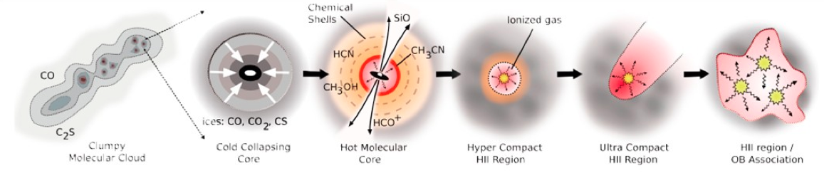
Masers and (Massive) Star Formation
Evolutionary Timeline of (high-mass) Star Formation
Infrared Dark Clouds Massive Protostars/YSOs Ionized HII Regions
Image Credit: Cormac Purcell
Where do masers fall in this picture?
Water Masers are collisionally pumped.
The water masers often occur in high-velocity, collimated outflows, but more generally trace post-shocked gas.
(class II) methanol masers are radiatively pumped.
They are located in warm & dense circumstellar gas and amplify IR radiation from YSOs
They are exclusively associated with high-mass star formation
Some may lie in infalling envelopes, rotating disks, outflow cavities

